Slide 1




SOURCE AnD PACKAGE TOURISM PRODUCTS AND SERVICES
D2.TCS.CL5.22 D2.TTA.CL2.18
Notes:
Trainer welcomes students to class.

Slide 2
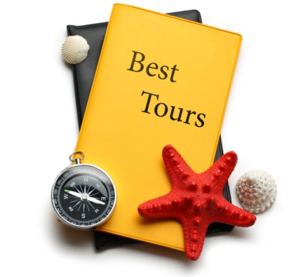
Subject elements
This unit comprises three Elements:
Describe the context for packages
Source products and services for packages
Create packages of products and services
Notes:
Trainer advises this Unit comprises three Elements, as listed on the slide explaining:
• Each Element comprises a number of Performance Criteria which will be identified throughout the class and explained in detail
• Trainees can obtain more detail from their Trainee Manual
• At times the course presents advice and information about various protocols but where their workplace requirements differ to what is presented, the workplace practices and standards, as well as policies and procedures must be observed.

Slide 3

Assessment
Assessment for this unit may include:
Oral questions
Written questions
Work projects
Workplace observation of practical skills
Practical exercises
Formal report from supervisor
Notes:
Trainer advises that assessment for this Unit may take several forms all of which are aimed at verifying they have achieved competency for the Unit as required.
Trainer indicates the methods of assessment that will be applied to them for this Unit.

Slide 4

Element 1:
Describe the context for packages
Notes:
Introduce topic.
Class Activity – General Discussion
Ask general questions:
What is a ‘package’?
What is included in a package?
What are the benefits of packages?

Slide 5
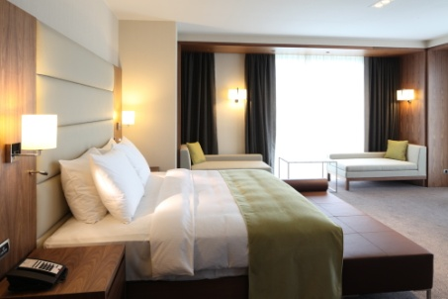
Describe the context for packages
Performance Criteria for this Element are:
Identify the clients for packages
Identify client requirements in relation to packages
Identify host enterprise requirements in relation to packages
Identify purposes of packages
Identify products and services for inclusion in packages
Notes:
Trainer identifies the Performance Criteria for this Element, as listed on the slide.

Slide 6
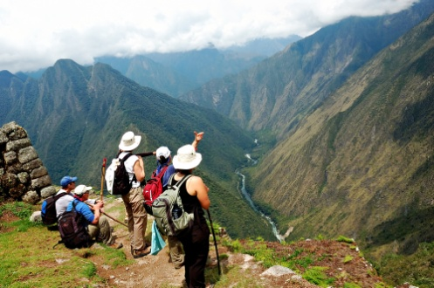
Tourism packages
Importance of tourism packages
Tourism packages are an integral part of the travel and tourism industry
The ever increasing rise in popularity in tourism packages demonstrates that it still is an attractive option for many clients in meeting their travel needs
Notes:
Class activity – Discussion
Who provides tour packages?
What types of packages exist?

Slide 7

Tourism packages
Variety of tourism packages
Today, travel packages are aimed at:
Different clients
With different budgets
Seeking different experiences
For different durations
In all corners of the world
Notes:
Class activity – Personal reflection of tour packages
Audience to reflect on tour packages they have taken in the past
Discuss the types of packages in today’s world

Slide 8

Tourism packages
What is packaging?
Many tourism businesses package various tourism products and present them as a combined product to their client
This is called packaging
Any type of tourism component can be packaged with another
Notes:
Class activity – Discussion
What is included in a tourism package?

Slide 9

Tourism packages
Tour component products and services
Single or multiple products and services
Accommodation
Meals
Transfers and transport, for example air, sea, rail, car hire
Entrances to attractions for example wildlife parks, theme parks, national parks, museums
Notes:
Class activity – Discussion
Provide examples of each type of component

Slide 10

Tourism packages
Tour component products and services
Tourist guiding services & tours
Tickets to entertainment, events or adventure activities
Venue and equipment hire
Meetings, events, functions and conferences
COMPLETE ACTIVITY 1
Notes:
Class activity – Discussion & Activity
Provide examples of each type of component
Complete Activity 1

Slide 11

Types of clients
Types of clients
Domestic and international people
Males and females
People from different age groups
Special interest groups
Special needs clients
Open groups
Homogenous target market groups as defined by various demographic characteristics
Notes:
Class activity – Discussion
Provide examples of each type of client
What are their needs?

Slide 12

Types of tour operators
Types of tour operators
Almost every tourism operator gets involved with combining individual components and selling them as a package:
Travel agents
Day tour operators
Hotels
Outbound tour wholesalers
Inbound tour operators
Conference organisers
Notes:
Class activity – Discussion
How do these tourism operators make packages?

Slide 13

Characteristics of clients
Understanding characteristics of market segments
There are many ways to identify different segments of clients seeking tourism packages
Each organisation will breakdown the potential market to suit the needs and to help identify the potential of each group
Notes:
Class activity – Discussion
What are examples of different market segments?
What are characteristics of these segments?

Slide 14

Characteristics of clients
Generic market segments
Age
Social background
Economic background
Cultural background
Special interests
Physical and mental abilities
Dietary needs
Notes:
Class activity – Discussion
What are examples of subcategories for these different market segments?

Slide 15

Characteristics of clients
Specialised market segments
Business
Leisure
Religious
Sporting
Outbound Tourists
Inbound Tourists
Domestic Tourists
International Tourists
Notes:
Class activity – Discussion
What are examples of subcategories for these different market segments?
What are their needs?

Slide 16

Identify client requirements
Importance of identifying client requirements
Once different types of clients and market segments have been indentified, it is essential to understand what their needs may be, when seeking appropriate tourism packages
Whilst there will be generic needs that all clients will have, each market segment will also have their own specialised needs that must be addressed
Notes:
Class activity – Discussion
How can you identifying client requirements?

Slide 17

Identify client requirements
Understanding needs, wishes and expectations
What is the difference between:
Needs
Wishes
Expectations
Notes:
Class activity – Discussion
Discuss the questions in the slide.
Provide examples of each.

Slide 18

Identify client requirements
Generic needs
Value for money
‘Offering’ reflecting what was advertised
Expectations met / exceeded
To receive friendly service
To be safe
Notes:
Class activity – Discussion
Discuss these needs?
How can you cater to these?

Slide 19

Identify client requirements
Generic needs
To be dealt with in a prompt and courteous manner
To receive assistance when necessary
To be in comfortable, clean surroundings
To feel remembered and recognised
To be heard and understood
Notes:
Class activity – Discussion
Discuss these needs?
How can you cater to these?

Slide 20

Identify client requirements
Specific target market needs
What are the specific needs of these market segments?
Business
Women
Family
Leisure
Elderly
Others
Notes:
Class activity – Discussion
What are the needs for each of these customer types?
Discuss these needs?
How can you cater to these?

Slide 21

Identify client requirements
Tour client needs
Quiet time
Free time
Personal enjoyment of site
Adequate rest time
‘Up close and personal’ opportunities
Access to areas which are ‘off limits’ to other people or are not part of a tour
Special photo opportunities with animals, characters or unique sights
COMPLETE ACTIVITY 2
Notes:
Class activity – Discussion & Activity
How can you accommodate these needs when designing packages?
Complete Activity 2

Slide 22

Identify tourism trends
Importance of identifying industry trends
Not only is it important to understanding of the needs of possible clients and market segments it is also important to understand the travel trends that are affecting the tourism industry:
Why is it important to understand industry trends?
How can you find out about industry trends?
Notes:
Class activity – Discussion
Discuss the questions in the slide.

Slide 23

Identify tourism trends
Current tourism trends
Leisure time
Demographic factors
Lifestyle
Environmental tourism
Sustainable tourism
Notes:
Class activity – Discussion
What are examples of trends for each of these points?
How can these trends affect tour packages that may be created?
Identify packages based on these trends?

Slide 24

Identify tourism trends
Current tourism trends
Changes in the way holidays are booked
Growth in additional holidays and short breaks
Destination choice
Increased awareness of the needs of disabled people
Notes:
Class activity – Discussion
What are examples of trends for each of these points?
How can these trends affect tour packages that may be created?
Identify packages based on these trends?

Slide 25

Identify tourism statistics
Statistics
Statistics is the study of the collection, analysis, interpretation, presentation, and organisation of data.
Why is it important to gather statistics?
How can it benefit customers?
What information do you seek under each category?
How can you gather this information?
Notes:
Class Activity – Identify importance of tourism statistics
Discuss questions in the slide

Slide 26

Identify tourism statistics
Industry statistics
Statistics produced by research organisations on visitor numbers and tourist origins
Statistics available in reports from government on visitor number and tourist origins
Statistics available in reports from industry on visitor numbers and tourist origins
Notes:
Class Activity – Identify importance of tourism industry statistics
What information do you seek under each category?
How can you gather this information?

Slide 27

Identify tourism statistics
Industry statistics
Internal figures
Industry trends reports
International visitor statistics on arrivals, departures, visitor nights
Visitor profiles including tourist origins, volume
Industry and government research reports on industry trends, current development activity, forecasts of future developments
Notes:
Class Activity – Identify importance of tourism industry statistics
What information do you seek under each category?
How can you gather this information?

Slide 28

Identify tourism statistics
Industry statistics
Types of tourism businesses
Types and demographics of clients
Top destinations
Reasons for stays
Current industry information
Destination countries
Notes:
Class Activity – Identify importance of tourism industry statistics
What information do you seek under each category?
How can you gather this information?

Slide 29

Identify tourism statistics
Industry statistics
Departure months
Length of stay
Type of organisation for the trip
Spending patterns of consumers
Characteristics of consumers
Notes:
Class Activity – Identify importance of tourism industry statistics
What information do you seek under each category?
How can you gather this information?

Slide 30

Identify tourism statistics
Researching tourism trends and statistics
With this information you will be able to start researching for suitable products and services for packaging.
Several methods should be used including:
Desk research
Personal contact
COMPLETE ACTIVITY 3
Notes:
Class Activity – Identify importance of tourism industry statistics & Activity
How can you gather information using these methods?
Complete Activity 3

Slide 31

Seek client personal information
Name, initial and title
Dates of birth for passengers, in particular children
Contact details for home, work and mobiles
Special meal requests or seating preferences
Frequent flyer information and club memberships
Details of travel such as dates, places and products
Payment details
Wholesaler or Consolidator used
Notes:
General Discussion
Discuss information to be collected for each of these points.
Role Play
In pairs, one person is the travel agent and the other person the customer seeking a travel quotation.
The travel quotation will be based on the thoughts of the customer.
The travel agent must gather information and write answers done in an accurate manner.

Slide 32

Identify client travel details and requirements
Name and contact details of the client including details of the traveller where the contact is not the user
Proposed itinerary, including destinations (intermediary and final destinations), services and activities required, attractions to be visited
Product and service preferences
Practicality
Notes:
General Discussion
Discuss information to be collected for each of these points.
Role Play
In pairs, one person is the travel agent and the other person the customer seeking a travel quotation.
The travel quotation will be based on the thoughts of the customer.
The travel agent must gather information and write answers done in an accurate manner.

Slide 33

Identify client travel details and requirements
Service styles and standards
Accommodation and dining/catering requirements
Budget
Dates and times, including specific days, seasonal imperatives and duration
Timing and duration issues, including constraints and the need for integration with an associated tour or travel program
Notes:
General Discussion
Discuss information to be collected for each of these points.
Role Play
In pairs, one person is the travel agent and the other person the customer seeking a travel quotation.
The travel quotation will be based on the thoughts of the customer.
The travel agent must gather information and write answers done in an accurate manner.

Slide 34

Identify client travel details and requirements
Client numbers and classification, including adults, children, babies and groups
Preferred travel options, including destination travel requirements
Reasons for trip
Non-negotiable elements
Previous history of the client in relation to bookings made
Cultural and religious issues
Notes:
General Discussion
Discuss information to be collected for each of these points.
Role Play
In pairs, one person is the travel agent and the other person the customer seeking a travel quotation.
The travel quotation will be based on the thoughts of the customer.
The travel agent must gather information and write answers done in an accurate manner.

Slide 35

Understanding client needs, wants and expectations
Using a Quotation Planner
Each organisation will have established pro-formas or documents which must be used by staff when collecting information from customers in which quotations can be based around.
What is the benefit of using a quotation planner?
What information do you wish to collect?
COMPLETE ACTIVITY 4
Notes:
Class Activity – Demonstration and Activity
Trainer to show audience copies of a planner.
Audience to create their own planners or think of questions they would include in their own planners.
Complete Activity 4

Slide 36

Identify host requirements
Importance of understanding host requirements
Whilst the needs of the client are of primary concern when developing packages, it is essential that packages are researched and constructed in a manner that complies with your tourism organisation
Notes:
Class Activity – Discussion
Ask general questions:
Why is it important?
What needs to be considered?

Slide 37

Identify host requirements
Review host enterprise requirements
Business objectives
Key market segments or clients
Types and style of tourism activities and products current offered
Types of products or services that could be combined with current activities and services
How the packaging could be used to improve service
Notes:
Class Activity – Discussion
Ask general questions:
What are examples of requirements under each point?

Slide 38

Identify host requirements
Review host enterprise requirements
Enhancing and expanding product range including product initiatives that conform to business plan and marketing objectives
Movement into new target markets
Reputation and image
Business agreements, including franchise and other contractual arrangements
Notes:
Class Activity – Discussion
Ask general questions:
What are examples of requirements under each point?

Slide 39

Identify host requirements
Review host enterprise requirements
Meeting competition
Involvement of colleagues in determining requirements
Potential increase in business and profitability
COMPLETE ACTIVITY 5
Notes:
Class Activity – Discussion & Activity
Ask general questions:
What are examples of requirements under each point?
Complete Activity 5

Slide 40

Types of tour packages
Variety of tour packages
Recently, the tourism industry has responded positively with ever expanding needs for new and variety of tour packages demanded by clients, in all corners of the world:
What diversity of tours are there?
Notes:
Class Activity – Discussion
Ask general questions:
Discuss the question in the slide.

Slide 41

Types of tour packages
Independent Tours
An independent tour is prepared to meet the needs of an individual client's specification. In this tour, a traveler is free and independent to select any component for his journey:
What are examples of these tours?
What are the advantages / disadvantages of these tours?
Notes:
Class Activity – Discussion
Ask general questions:
Discuss the question in the slide.

Slide 42

Types of tour packages
Inclusive Tours
Tour components are purchased, combined and sold as a package at an inclusive price to clients by a tour operator is known as an inclusive tour:
What are examples of these tours?
What are the advantages / disadvantages of these tours?
Notes:
Class Activity – Discussion
Ask general questions:
Discuss the question in the slide.

Slide 43

Types of tour packages
Escorted Tours
This type of tour is also known as a ‘Conducted Tour’.
A tour escort is provided from the starting point back to the point of return to accompany the tour members.
What are examples of these tours?
What are the advantages / disadvantages of these tours?
Notes:
Class Activity – Discussion
Ask general questions:
Discuss the question in the slide.

Slide 44

Types of tour packages
Business Tours
Two forms of business tours have received a special attention from the tour operators.
These are:
Conference Package
Special Events Package
Notes:
Class Activity – Discussion
Ask general questions:
What are examples of these tours?
What are the advantages / disadvantages of these tours?

Slide 45

Types of tour packages
Incentive tours
Offered by a business organisation to its employees and their spouses as reward for some special endeavour or as a spur to achievement:
What are examples of these tours?
What are the advantages / disadvantages of these tours?
Notes:
Class Activity – Discussion
Ask general questions:
Discuss the question in the slide.

Slide 46

Types of tour packages
Special interest tours
Inbound Tour Operators and Outbound Tour Operators regularly design on-off itineraries.
Special interest groups generally share a common interest and may want to book specialist products or services:
What are examples of these tours?
What are the advantages / disadvantages of these tours?
Notes:
Class Activity – Discussion
Ask general questions:
Discuss the question in the slide.

Slide 47

Purpose of tour packages
Specific age holidays, packages and tours
General interest
Conferences
Social events
Holidays and recreation
Tour programs
Incentives
Notes:
Class Activity – Discussion
Ask general questions:
What are examples of inclusions for these tours?

Slide 48

Purpose of tour packages
Series tours
Eco-tours
Education
Experience
Fitness
Excitement / action experiences
Celebration of an event / historical date
Notes:
Class Activity – Discussion
Ask general questions:
What are examples of inclusions for these tours?

Slide 49
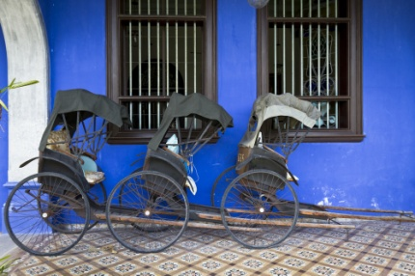
Purpose of tour packages
Money raising
Language
Music
Sports
The environment
Culture
Arts
Notes:
Class Activity – Discussion
Ask general questions:
What are examples of inclusions for these tours?

Slide 50
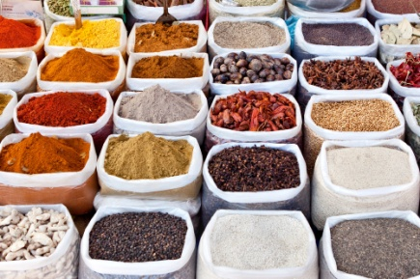
Purpose of tour packages
Animals
Food
History
Flora and fauna
Natural attractions
Shopping
Four wheel driving
Notes:
Class Activity – Discussion
Ask general questions:
What are examples of inclusions for these tours?

Slide 51

Purpose of tour packages
Camping
Cruises
Luxury
Budget
Snow skiing
Diving
Rail
Notes:
Class Activity – Discussion
Ask general questions:
What are examples of inclusions for these tours?

Slide 52

Purpose of tour packages
Coach
Safaris
Family
Overland treks / walking
Beach
Wedding ceremonies
Notes:
Class Activity – Discussion
Ask general questions:
What are examples of inclusions for these tours?

Slide 53

Location of tours
Whilst tours can be conducted anywhere in the world, they are normally categorised as being held:
On-site
‘Elsewhere’
COMPLETE ACTIVITY 6
Notes:
Class Activity – Discussion & Activity
Ask general questions:
What are popular locations for tours in your country?
Why?
Complete Activity 6

Slide 54
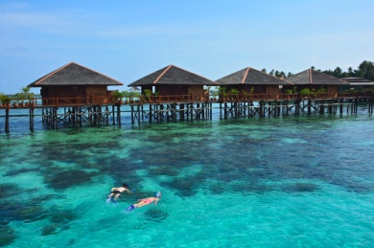
Identify package products and services
Identify products and services for inclusions in packages
Identifying, sourcing and selecting product and services for inclusion in a package is reliant on finding a balance of meeting your client needs with understanding of what is possible:
What needs to be considered?
Notes:
Class Activity – Discussion
Ask general questions:
Discuss the question in the slide.

Slide 55

Identify package products and services
Identify products and services for inclusions in packages
It is also based on identifying:
Availability of appropriate products and services to suit the stated or established client needs
Suitable suppliers or wholesalers that can provide these products
Prices that meet the passengers budget
Notes:
Class Activity – Discussion
Ask general questions:
Discuss these considerations.

Slide 56

Identify package products and services
Importance of collecting information on products and services for packages
This includes finding the answers to questions such as:
What is it?
Where is it?
How do you get it?
How long does it take?
What is included?
What is excluded?
What is it like?
How much does it cost?
What would you recommend?
Notes:
Class Activity – Discussion
Ask general questions:
Discuss these considerations.

Slide 57

Identify package products and services
General products and services sought by clients
Products and services can be divided into the main areas of :
Air – air travel and associated taxes
Land – anything that is not air travel or a cruise
Sea – cruises, ferries etc
Auxiliary – any product or service that supports the travel experience
Notes:
Class Activity – Identify products and services
Audience to prepare a list of possible products and services under each category

Slide 58

Identify package products and services
Land arrangements
Accommodation
Transfers
Transportation
Tours
Attractions, activities and entertainment
Notes:
Class Activity – Identify products and services
Audience to prepare a list of possible products and services under each category

Slide 59

Identify package products and services
Auxiliary products and services
Travel Insurance
Currency and banking
Visas
Merchandise
Airport parking
COMPLETE ACTIVITY 7
Notes:
Class Activity – Identify products and services & Activity
Audience to prepare a list of possible products and services under each category
Complete Activity 7

Slide 60

Element 2:
Source products and services for packages
Notes:
Introduce topic.
Class Activity – General Discussion
Ask general questions:
How can you source products and services for packages?

Slide 61

Source products and services for packages
Performance Criteria for this Element are:
Identify sources of information for products and services
Research information sources to obtain targeted information
Assess applicability of identified products and services to proposed packages
Select products and services for the package
Notes:
Trainer identifies the Performance Criteria for this Element, as listed on the slide.

Slide 62

Sources of information
Identify potential sources of information
There are endless sources of information that can be collected, analysed and used by a travel and tourism organisation for the benefit of the organisation itself or to assist customers with potential travel plans.
This section will explore:
Types of tourism industry organisations
Identify types of product and services information
Sources of product and services information
Notes:
Class Activity – General Discussion
What are examples for each of these points.

Slide 63

Travel and tourism businesses
Identify travel and tourism businesses
When compiling product information for inclusion in packages it is essential to identify the different types of businesses in which your potential customers may use:
What types of businesses do you seek product information from?
Notes:
Class Activity – General Discussion
Discuss question in the slide.

Slide 64

Travel and tourism businesses
Transportation
Airlines
Cruise operators
Railway operators
Bus lines
Car rental businesses
Limousine hire
Taxis
Notes:
Class Activity – Identify businesses for each type of business
Identify actual companies for each type of tourism business

Slide 65

Travel and tourism businesses
Suppliers and providers of support and ancillary services
Travel insurance providers
Finance providers
Currency exchange
Conference and similar venues
Interpreters
Notes:
Class Activity – Identify businesses for each type of business
Identify actual companies for each type of tourism business

Slide 66
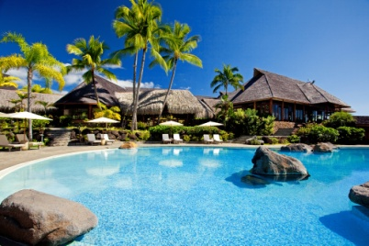
Travel and tourism businesses
Accommodation
Hotels and motels
Guest houses
Bed and breakfasts
Caravan parks and camping grounds
Resorts
Time share properties
Apartments, villas and cottages
Conference and exhibition centres
Notes:
Class Activity – Identify businesses for each type of business
Identify actual companies for each type of tourism business

Slide 67
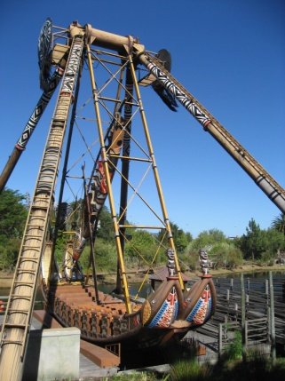
Travel and tourism businesses
Attractions and Theme Parks
Museums and galleries
National parks, wildlife parks and gardens
Theme parks
Heritage sites and centres
Sport and activity centres
Aquarium and zoos
Notes:
Class Activity – Identify businesses for each type of business
Identify actual companies for each type of tourism business

Slide 68
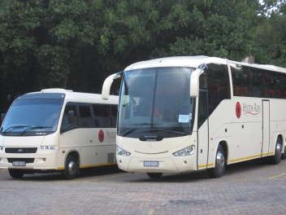
Travel and tourism businesses
Tour Operators
A tour operator typically organises sightseeing tours and accommodation in a particular destination or region.
They act as a middle person between the Wholesaler and the Principal or Supplier of the product
Notes:
Class Activity – Identify businesses for each type of business
Identify actual companies for each type of tourism business

Slide 69

Travel and tourism businesses
Inbound Tour Wholesaler
An Inbound Tour Wholesaler packages products to form a trip for an overseas market travelling to a specific country
Outbound Tour Wholesaler
An Outbound Tour Wholesaler negotiates product from International Suppliers for clients in a specific travelling to an international destination
Notes:
Class Activity – Identify businesses for each type of business
Identify actual companies for each type of tourism business

Slide 70

Travel and tourism businesses
Retail Travel Agents
A Retail Travel agent is the go-between between the client and the Wholesaler
It is the Retail agent who obtains all the relevant details from a client to enable them to make a booking through a Wholesaler
Notes:
Class Activity – Identify businesses for each type of business
Identify actual companies for each type of tourism business

Slide 71

Travel and tourism businesses
Local, regional and national information services
These information services exist to assist the public and Travel agents in obtaining information on a particular region from the experts
This can be at a local, regional or national level
Notes:
Class Activity – Identify businesses for each type of business
Identify actual companies for each type of tourism business

Slide 72

Travel and tourism businesses
MICE
Meetings
Incentives
Conventions
Exhibitions
Notes:
Class Activity – Identify businesses for each type of business
Identify actual companies for each type of tourism business

Slide 73

Travel and tourism businesses
Ministries of Tourism
Almost every country within the ASEAN region will have dedicated government ministry specifically focused on the tourism industry
Their role is to regulate and manage the industry
Notes:
Class Activity – Identify businesses for each type of business
Identify actual companies for each type of tourism business

Slide 74

Travel and tourism businesses
Tourism Boards
Coordinate the efforts of hotels, airlines and travel agents to develop the tourism industry of the country
Initiate new marketing ideas to promote image aboard
Provide travel agent licensing and tourist guide training
Promote the development of infrastructure and tourist attractions
Organise events to attract visitors
Notes:
Class Activity – Identify businesses for each type of business
Identify actual companies for each type of tourism business

Slide 75

Travel and tourism businesses
Industry Authorities
Authorities are established, either by a government or working closely with government to provide services relating to the tourism industry
Notes:
Class Activity – Identify businesses for each type of business
Identify actual companies for each type of tourism business

Slide 76

Travel and tourism businesses
Industry Associations
Industry associations are bodies that all businesses can elect to join that serve specific and over-arching industry sectors.
Representing the industry
Offer legal advice
Provide training
Identify cost savings
COMPLETE ACTIVITY 8
Notes:
Class Activity – Identify businesses for each type of business & Activity
Identify actual companies for each type of tourism business
Complete Activity 8

Slide 77

Identify product information
Identify product information to gather
Before seeking information from each of these types of businesses it is important to identify the types of information that you require from each to help you advise your clients in their future travel needs:
What types of product information do you want to gather?
Notes:
Class Activity – Question
Discuss the question in the slide.

Slide 78

Identify product information
Destination information
General destination information
Statistical information
Currency
Maps
Travel guides
Events
Notes:
Class Activity – Question
Discuss the types of information to be collected under each point?
How can you collect this information?
What format would you like it in?

Slide 79

Identify product information
Destination information
Languages
Safety
Government information
Time zones
Communications
Notes:
Class Activity – Question
Discuss the types of information to be collected under each point?
How can you collect this information?
What format would you like it in?

Slide 80
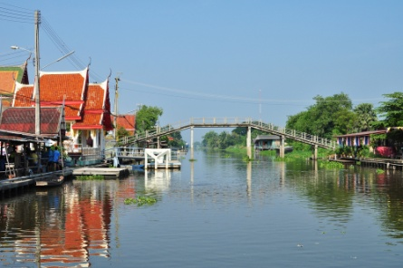
Identify product information
Local community information
Local attractions
Shopping and retail areas
Events and festivals
Eateries
Supermarkets
Local transport
Activities
Places of worship
Notes:
Class Activity – Question
Discuss the types of information to be collected under each point?
How can you collect this information?
What format would you like it in?

Slide 81

Identify product information
International destination information
When providing information on international destinations to your customers, you will need to advise them of the government regulations that apply when people wish to leave the country:
What information do you need to gather and explain to clients wishing to travel overseas?
Notes:
Class Activity – Question
Discuss the questions in the slide.

Slide 82

Identify product information
Tours
Company name, name of tour and duration
Departure date, time and location address
End date, time and location address
Type of accommodation e.g. single, twin-share
Tour company specific baggage labels
Hotel list
Tour information booklet
Included services
Notes:
Class Activity – Question
Discuss the types of information to be collected under each point?
How can you collect this information?
What format would you like it in?

Slide 83
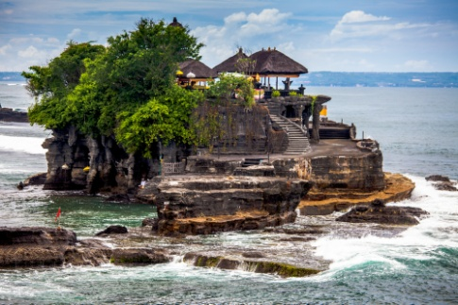
Identify product information
Attractions
Attractions can include:
Historic sites
Scenic location
Special event
Tourist attractions can be:
Natural
Man-made
Notes:
Class Activity – Question
Discuss the types of information to be collected under each point?
How can you collect this information?
What format would you like it in?

Slide 84

Identify product information
Activities
What are examples of tourism related activities?
Notes:
Class Activity – Question
Discuss the questions in the slide.

Slide 85

Identify product information
History
Many people are interested in history, and therefore information on the history of a destination can be important to customers
What are examples of history that attracts tourism?
Notes:
Class Activity – Question
Discuss the questions in the slide.

Slide 86

Identify product information
Geographical features
Mountain ranges
Lakes
Rivers
Caves
Waterfalls
Rock formations
Beaches
National parks
Notes:
Class Activity – Question
Discuss the types of information to be collected under each point?
How can you collect this information?
What format would you like it in?

Slide 87

Identify product information
Local customs and culture
Every destination will have customs that are specific to that place and that particular culture.
What are examples of:
Local customs
Local culture
Notes:
Class Activity – Question
Discuss the questions in the slide.

Slide 88

Identify product information
Climate
It is important that you understand the weather conditions and patterns of the destination:
Why is this important?
How can you identify climatic conditions?
Notes:
Class Activity – Question
Discuss the questions in the slide.

Slide 89

Identify product information
Accommodation
Room types
Tariffs
Products and services
Room facilities
Location and distance to attractions
Packages
Blocked dates
Seasons and times
Minimum purchase
Notes:
Class Activity – Question
Discuss the types of information to be collected under each point?
How can you collect this information?
What format would you like it in?

Slide 90

Identify product information
Accommodation
Booking and stay requirements
Property name and address
Room type and category
Number of nights
Check-in and check-out dates
Check-in and check-out times
Notes:
Class Activity – Question
Discuss the types of information to be collected under each point?
How can you collect this information?
What format would you like it in?

Slide 91
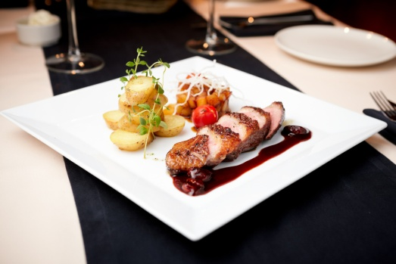
Identify product information
Accommodation
Day use or late check-out if applicable
Inclusions
Extra charges payable direct
Special requests
Special promotions
Notes:
Class Activity – Question
Discuss the types of information to be collected under each point?
How can you collect this information?
What format would you like it in?

Slide 92
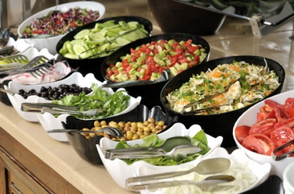
Identify product information
Amenities and services
Amenities and services refer to the provision of basic services for travellers including:
Toilet blocks
Water
Electricity
Food and beverage including restaurants, cafes, bistros
Medical services
Notes:
Class Activity – Question
Discuss the types of information to be collected under each point?
How can you collect this information?
What format would you like it in?

Slide 93

Identify product information
Amenities and services
Banks and post offices
General safety facilities including fire, police emergency services
Entertainment
Sporting
Shopping
Notes:
Class Activity – Question
Discuss the types of information to be collected under each point?
How can you collect this information?
What format would you like it in?

Slide 94

Identify product information
Airlines
Airline or combination of airlines
Airport codes
Airline codes
City codes
Flight numbers
Schedules / timetables
Destinations
Routing
Notes:
Class Activity – Question
Discuss the types of information to be collected under each point?
How can you collect this information?
What format would you like it in?

Slide 95

Identify product information
Airlines
Origin and destination
Code share flights
Normal fares
Discounted fares, including infants, children, students, pensioners and groups
Fares for unaccompanied children
Promotional fares and packages
Taxes
Notes:
Class Activity – Question
Discuss the types of information to be collected under each point?
How can you collect this information?
What format would you like it in?

Slide 96

Identify product information
Airlines
General air travel rules and restrictions
Class of travel
Stopovers
Mileage restrictions allowed
Minimum and maximum stays
Ticketing time limit
Payment conditions
Notes:
Class Activity – Question
Discuss the types of information to be collected under each point?
How can you collect this information?
What format would you like it in?

Slide 97

Identify product information
Car hire
Company, category, type
Pick-up and drop-off depots
Pick-up and drop-off dates and times
Inclusions and exclusions
Special requests
Notes
Notes:
Class Activity – Question
Discuss the types of information to be collected under each point?
How can you collect this information?
What format would you like it in?

Slide 98

Identify product information
Cruises
Name of the ship and voyage number
Embarkation date, time and port address
Disembarkation date, time and port address
Grade/category and cabin type and number
Passenger dining preference
Pre-booked special requirements
Notes:
Class Activity – Question
Discuss the types of information to be collected under each point?
How can you collect this information?
What format would you like it in?

Slide 99

Identify product information
Transfers
Name of company providing the transfer
Local address and local telephone contact
Type of transfer
Pick-up date, time and location
Drop-off date, location
Special instructions in relation to transfer
Notes:
Class Activity – Question
Discuss the types of information to be collected under each point?
How can you collect this information?
What format would you like it in?

Slide 100

Identify product information
Rail
Name of Pass
Duration and type of pass
Validity dates
Notes:
Class Activity – Question
Discuss the types of information to be collected under each point?
How can you collect this information?
What format would you like it in?

Slide 101

Product and services information
Sources of travel product and services information
Brochures/DVDs
Hotel and accommodation guides and indexes
Atlases, maps and encyclopedias
Travel guides
Individual timetables
Automated information systems
Computerised Reservations Systems (CRS)
Notes:
Class Activity – Identify sources of information
Trainer to show sources of information
What information can be gathered from each source?

Slide 102

Product and services information
Sources of travel product and services information
International airline guides
Travel Trade Yearbook
Travel Information Manual (TIM)
Passenger air tariff
Trade press
General print and electronic media, travel magazines and even news bulletins for current issues
Notes:
Class Activity – Identify sources of information
Trainer to show sources of information
What information can be gathered from each source?

Slide 103

Product and services information
Sources of travel product and services information
Educationals
Product familiarisations
Other organisations in the industry
The internet, travel websites, travel advisor, blogs
Travel companies product launches, travel shows and information nights
Government agencies such as national parks and wildlife services or government tourism offices
Notes:
Class Activity – Identify sources of information
Trainer to show sources of information
What information can be gathered from each source?

Slide 104

Product and services information
Sources of travel product and services information
Intranet Websites
Internal information databases
Product manuals
Supplier information and sales kits and their sales representatives
Destination and product experts in wholesale reservation call centres
Notes:
Class Activity – Identify sources of information
Trainer to show sources of information
What information can be gathered from each source?

Slide 105

Product and services information
Sources of travel product and services information
Confidential and general industry tariffs
Preferred contracts and/or agreements
Official country tourist offices, authorities and bureaus
Your own travel experience
Colleagues
Notes:
Class Activity – Identify sources of information
Trainer to show sources of information
What information can be gathered from each source?

Slide 106

Research information sources
Importance of research
Now that you have identified different tourism businesses that provide tourism products and services that can be included in tourism packages, it is now time to start the research process
The aim of the research process is to collect accurate and relevant information to meet the needs of the client and any requests they have made
Notes:
Class Activity – Discuss
Describe the process that you have used in the past when conducting research.

Slide 107

Research information sources
Research considerations
The need to identify the research points
Collecting primary and secondary data
Recollection of personal observations
Accessing internal sources of information
Gathering feedback from customers
Accessing external sources of information
Establishing industry networks
Notes:
Class Activity – Discuss
What are the activities and benefits for each of these steps?

Slide 108

Research information sources
Defining the research topic
The first step is to try to identify exactly where the focus of research and information collection should be concentrated on
Notes:
Class Activity – Discuss
For a case study of your choice, identify:
Research topics

Slide 109

Research information sources
Collect primary and secondary data
Data is a piece of information that can be collected and interpreted by an organisation for their use.
The two most common sources of data are:
Primary data – collected for a specific purpose
Secondary data – generic information
Notes:
Class Activity – Discuss
What are examples of each?

Slide 110

Primary data
Primary data
Primary research data is newly generated research information that you yourself or the organisation create.
Customer surveys
In-house questionnaires and feedback sheets
Focus groups
Electronic responses on the website
Observation
Notes:
Class Activity – Discuss
What are other examples of primary data?

Slide 111

Primary data
Qualitative or quantitative research
Primary data is considered to be either:
Qualitative research
Quantitative research
Notes:
Class Activity – Discuss
What is the difference between these two types of research?

Slide 112

Primary data
Qualitative research
Qualitative research does not look at numbers but tries to find out the reasoning behind certain actions, procedures, activities or ways of thought
Quantitative research
Quantitative research is market research, based on structured, closed-ended questionnaires, which aims to gather responses that can be summarised in numbers
Notes:
Class Activity – Discuss
What are examples of each?

Slide 113

Secondary data
Importance of secondary data
Secondary data is information that already exists.
It just needs to be found:
What are the benefits of secondary data?
What are sources of secondary data?
Notes:
Class Activity – Discuss
Discuss questions in the slide.

Slide 114
Secondary data
Types of secondary data
Domestic and international visitor statistics on departures, expenditure, visitor nights
Visitor profiles including tourist origins, volume, purpose of trip, seasonality, accommodation, transport and expenditure
Industry and government research reports on industry trends, current development activity and forecasts of future developments
Notes:
Class Activity – Discuss
What are the benefits of collecting these pieces of data?
What other types of secondary data would you collect?

Slide 115

Secondary data
Types of secondary data
Client feedback
Feasibility studies for new developments or products
Responses to surveys, questionnaires on preferences, needs and current tourist activities
Notes:
Class Activity – Discuss
What are the benefits of collecting these pieces of data?
What other types of secondary data would you collect?

Slide 116

Secondary data
Sources of secondary data
Government statistics
Libraries
Internet
Government websites
Private market research firms
Trade, professional and business associations
Newspapers and magazines
Business and industry-specific journals and periodicals
Notes:
Class Activity – Discuss
What information is found from these sources?
What types of secondary data would you seek?

Slide 117

Observations
Recollection of personal observations and experiences
Previous bookings
Discussions had with previous clients
Familiarisation tours previously conducted
Personal notes
Report and findings
Log books
Records of interviews
Notes of first-hand meetings
Notes:
Class Activity – Discuss
Why is this source of information often the most effective?

Slide 118

Accessing internal information
Arrange to receive internal information
Who can you receive information from?
What types of information can you receive?
How can you receive the information?
Notes:
Class Activity – Discussion
Ask general questions:
Discuss the questions in the slide.

Slide 119
Accessing internal information
Extract data from internal information sources
In the majority of cases, tourism product and service information that is required for possible inclusion tourism packages service activities can be obtained through the investigation and extraction of data from internal information systems:
What are examples of internal information sources?
Notes:
Class Activity – Discuss
Discuss question in the slide.

Slide 120

Accessing internal information
Types of internal information sources
Customer databases
Sales figures and statistics
Data from sub-agencies and head office
Customer feedback information
Automated information systems
Computerised reservation systems
Products and services inventories
Notes:
Class Activity – Discuss
What information can come from each of these sources?

Slide 121

Feedback from customers
Gathering information from customers
Feedback from other clients who have experienced a specific tourism product or service firsthand can be invaluable in recommending and finding out accurate information.
How can you gather:
Formal feedback
Informal feedback
Notes:
Class Activity – Discussion
Ask general questions:
Discuss methods of receiving feedback
What are the advantages of getting feedback in this manner?

Slide 122

Accessing external information
Arrange to receive external information
Telephoning targeted organisations
Making face-to-face requests of staff that visit their office
Making e-mail requests
Registering to receive information, newsletters and up-dates.
Paying to receive material
Asking organisations to forward information
Notes:
Class Activity – Discussion
Ask general questions:
Discuss activities associated with these points

Slide 123

Visit identified sources
At times you may be required to visit identified sources
This opportunity to gather a first-hand understanding of the source, including key personnel who will be instrumental in sharing information is very beneficial
Notes:
Class Activity – Discuss
What are the benefits of visiting identified sources?

Slide 124

Visit identified sources
Benefits of visiting identified sources
Meet key personnel
Talking with personnel to obtain, clarify, update and identify supplementary relevant information
Gain an understanding of the operation
Viewing operations and making personal observations
Clarify and explain your request for information
Receive electronic and hard copy files in a user friendly manner
Notes:
Class Activity – Discuss
Discuss these benefits of visiting identified sources

Slide 125

Visit identified sources
Benefits of visiting identified sources
Reviewing additional information available at the source
Get any questions answered
Identify the potential of informational sources that can be utilised at a later date
Recording interviews and taking photographs or other recorded images
Notes:
Class Activity – Discuss
Discuss these benefits of visiting identified sources

Slide 126

Establishing industry networks
Benefits of visiting identified sources
Developing your own industry network
Networking with industry colleagues
Notes:
Class Activity – Discuss
Discuss these benefits of setting up networks?
Who would you have in your network?

Slide 127

Assess practicality of products and services
Assess applicability of identified products and services to proposed packages
Once you have conducted research and collected a range of possible products and services for inclusion in a tourism package, it is important to assess where they can be included from a practical perspective:
What needs to be considered from a ‘practical’ point of view?
Notes:
Class Activity – Discussion
Ask general questions:
Discuss the question in the slide.

Slide 128

Assess practicality of products and services
Assess applicability of identified products and services to proposed packages
Determining rates, costs, fees, charges, taxes for each package component
Evaluating availability on a short-term and on-going basis, as required by the nature of the package
Calculating return on investment, including consideration of loss leader implications
Notes:
Class Activity – Discussion
Ask general questions:
Discuss the activities associated with each point

Slide 129

Assess practicality of products and services
Assess applicability of identified products and services to proposed packages
Assessing compatibility with company image and reputation
Verifying reputation of products and services, including assessment of client perceptions in relation to potential carriers, suppliers, destinations, products and services
Identifying features and benefits, including comparisons with similar packages offered by competitors
Notes:
Class Activity – Discussion
Ask general questions:
Discuss the activities associated with each point

Slide 130

Assess practicality of products and services
Assess applicability of identified products and services to proposed packages
Checking match between products/services and identified objectives and client demand/requests for the package
Determining destination characteristics
Understand local laws and regulations
Cultural considerations
Meeting special needs
Notes:
Class Activity – Discussion
Ask general questions:
Discuss the activities associated with each point

Slide 131

Select final products and services
Activities associated with selecting products and services
Identify list of final products and services
Identify suitable suppliers
Aligning with identified objectives
Complying with client requirements
Ensuring availability of products and services
Negotiating agreements with suppliers, carriers and providers
Organise supply of components and, where required, confirm agreements in writing
Notes:
Class Activity – Discussion
Ask general questions:
Discuss the activities associated with each point

Slide 132

Select final products and services
Activities associated with selecting products and services
Ensure specific inclusion descriptions and cancellation policies are confirmed with the supplier
Check and incorporate legal requirements for offering and promoting packages
Present pricing structures to clearly indicate all inclusions and exclusions and add-ons
Finalise and confirm details in writing
Ensuring value and potential saleability
Notes:
Class Activity – Discussion
Ask general questions:
Discuss the activities associated with each point

Slide 133

Identify types of suppliers
Types of suppliers
Principals/suppliers
Wholesalers/ tour operator
Inbound tour operators
Airlines, coach companies and rail
Retail agents
Ticket consolidators
State and regional tourism authorities
Conference, event and incentive companies
Notes:
Class Activity – Identify suppliers & Research activity
Trainer to discuss the different types of companies under each point
Audience to research companies under each of these points and identify the services they provide to travel agents and customers.

Slide 134

Existing agreements with suppliers
Consider existing agreements and preferred suppliers
A preferred agreement is a formal commercial agreement between a supplier and a travel agent which facilitates the payment of extra commission and other benefits by the supplier to the travel agent in exchange for the travel agents agreement to sell the suppliers product
Notes:
Class Activity – Identify preferred supplier agreement
Trainer to show example of a preferred supplier agreement.
What needs to be considered when developing a preferred supplier agreement?

Slide 135

Role of suppliers
Identify role of suppliers
Selling destinations you need
Selling transport you require
Selling accommodation style you require
Selling the appropriate level of comfort and inclusions your client needs
Having competitive prices and offering value for money for your client
Notes:
Class Activity – Discuss role of suppliers
What activities are performed under each of these points?
How can you improve these individual roles?

Slide 136

Role of suppliers
Identify role of suppliers
Having a reputation for reliability, efficiency and easy payment
Provide quality documentation
Employ helpful and knowledgeable staff
Pay competitive agent commission
Have local representation
Notes:
Class Activity – Discuss role of suppliers
What activities are performed under each of these points?
How can you improve these individual roles?

Slide 137

Identifying suppliers
Activities in identifying appropriate suppliers
Identifying client requirements in terms of products and services
Collecting information as to whom provides these products and services
Identifying suitable suppliers
Assessing alternatives against the identified requirements for the quotation
Notes:
Class Activity – Discuss role of identifying suppliers
Discuss these activities
Trainer to provide personal experiences in selecting suppliers.

Slide 138

Identifying suppliers
Activities in identifying appropriate suppliers
Evaluating the alternatives against the given criteria for the quotation
Accommodating host enterprise requirements in relation to the use of preferred suppliers, providers and carriers
Aligning with established client preferences and individual client market research data/feedback
Determine and select suppliers, providers and carriers to be provided as options to the client
COMPLETE ACTIVITY 9
Notes:
Class Activity – Discuss role of identifying suppliers & Activity
Discuss these activities
Trainer to provide personal experiences in selecting suppliers.
Complete Activity 9

Slide 139

Element 3:
Create packages of products and services
Notes:
Introduce topic.
Class Activity – General Discussion
Ask general questions:
What is associated with creating packages?

Slide 140

Create packages of products and services
Performance Criteria for this Element are:
Identify pre-planning requirements for packages
Determine components of individual packages
Determine duration for packages
Calculate price points for packages
Notes:
Trainer identifies the Performance Criteria for this Element, as listed on the slide.

Slide 141
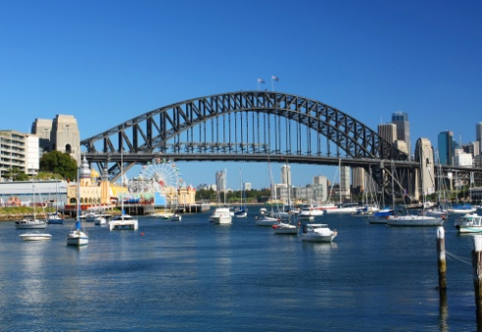
Create packages of products and services
Performance Criteria for this Element are:
Develop terms and conditions for the packages
Prepare draft itinerary for packages
Prepare sales monitoring arrangements for packages
Plan marketing activities for packages
Notes:
Trainer identifies the Performance Criteria for this Element, as listed on the slide.

Slide 142

Pre-planning for packages
Importance of pre-planning
As seen in previous sections, there are a number of considerations that must be taken into account before the final tourism products and services for a package have been selected:
What needs to be planned when constructing packages?
How should this information be recorded?
Notes:
Class Activity – Questions
Discuss the questions in the slide

Slide 143

Pre-planning for packages
Importance of pre-planning
This section will focus on how to gather and record product information gathered for the inclusion in packages.
Information relating to final travel packages are often given to clients to help them decide suitable travel arrangements in the form of:
Quotations
Itineraries
Notes:
Class Activity – Questions
Briefly introduce the concept of quotations and itineraries.

Slide 144

Recording packaging information
Purpose of having recording methods
Most travel agencies will use a combination recording system to record:
Customer detail
Supplier quotations
Travel agency quotations
Notes:
Class Activity – Questions
How can information be recorded?

Slide 145
Recording packaging information
Recording method considerations
Customer requirements
Information sourced to date
Information provided to customers to date
Communication discussions taken place to date
COMPLETE ACTIVITY 10
Notes:
Class Activity – Discussion and Questions & Activity
Discuss these considerations.
How would they affect the construction of a quotation?
Complete Activity 10

Slide 146

Planning package components
Types of considerations
Preferences
Budget
Time constraints
Notes:
Class Activity – Discussion
Discuss these considerations.
What other considerations would you take into account?

Slide 147
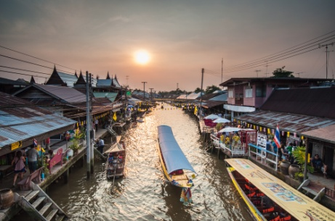
Packaging steps
Steps in creating packages
Identify the target group
Determine the theme of the tour
Now that you have your theme, establish objectives
Choose a title
Determine the length of the tour
Notes:
Class Activity – Discussion
Discuss these steps
They will be described in more detail in later sections

Slide 148

Packaging steps
Steps in creating packages
Create a tentative itinerary
Finalise the schedule
Arrange and confirm supply
Presentation of price
Present your packaged program
Notes:
Class Activity – Discussion
Discuss these steps
They will be described in more detail in later sections

Slide 149

Package components
Determine package components
Destination attractions
Destination facilities and services
Accessibility of the destination
Images of the destination
Inclusions and exclusions
Price to the client
Notes:
Class Activity – Discussion
Ask general questions:
What are points for consideration for each?

Slide 150

Package components
Destination attractions
Natural attractions
Built attractions
Cultural attractions
Social attractions
Notes:
Class Activity – Discussion
Ask general questions:
What are examples of each?

Slide 151

Package components
Destination facilities and services
Accommodation
Restaurants, bars and cafes
Transport at the destinations
Sports/activity
Retail outlets
Other services
Notes:
Class Activity – Discussion
Ask general questions:
What are examples of each?

Slide 152

Package components
Accessibility of the destination
Infrastructure
Equipment
Operational factors
Location to major attractions and amenities
Notes:
Class Activity – Discussion
Ask general questions:
What are examples of each?

Slide 153

Package components
Images and perceptions of the destination
The attitudes and images which clients have towards products strongly influence their buying decisions.
Destination images are not necessarily grounded in experience or facts but are powerful motivators in travel and tourism
Notes:
Class Activity – Discussion
Ask general questions:
Why are images so powerful in selling tourism packages?

Slide 154
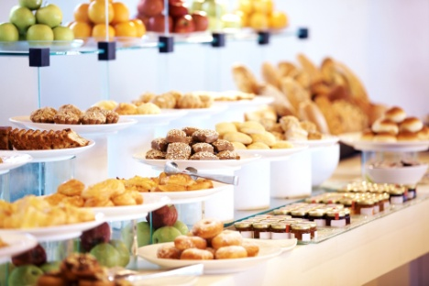
Package components
Inclusions and exclusions
What products and services are included or excluded in package prices can greatly influence the decision to purchase.
Inclusion
Exclusions
Add-ons
Available options, including substitutions and alternatives
COMPLETE ACTIVITY 11
Notes:
Class Activity – Discussion & Activity
Ask general questions:
What are examples of each?
What are essential inclusions for you when you travel?
Complete Activity 11

Slide 155
Determine package duration
Factors affecting the duration of packages
Commonly, the duration of a package will be determined by:
Client
Suppliers
Other influences
Notes:
Class Activity – Discussion
Ask general questions:
What are factors for each of these points?

Slide 156

Determine package duration
Duration factors determined by the client
Their budget
Designated dates
Preferred destinations
Preferred products and services
Notes:
Class Activity – Discussion
Ask general questions:
Provide examples of how these factors affect the duration of a tour

Slide 157
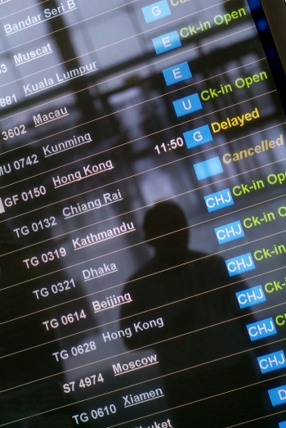
Determine package duration
Duration factors determined by suppliers
Schedules of set tours
Schedules of travel suppliers
Supply and demand
Supplier booking conditions
Notes:
Class Activity – Discussion
Ask general questions:
Provide examples of how these factors affect the duration of a tour

Slide 158
Determine package duration
Duration factors determined by other influences
Whilst there are an endless amount of influences affecting package durations, some of these include:
Timing of specific events
Seasonality
Notes:
Class Activity – Discussion
Ask general questions:
Provide examples of how these factors affect the duration of a tour
What are other examples?

Slide 159

Determine package duration
Determine duration of packages
This process will include:
Formulating packages to accommodate differing timelines
Checking availability of products and services
Adding and removing inclusions
Providing alternate dates, suppliers or routes
Complying with agreed arrangements
COMPLETE ACTIVITY 12
Notes:
Class Activity – Discussion & Activity
Ask general questions:
Discuss the processes associated with these steps
Complete Activity 12

Slide 160

Calculating price points for packages
Calculate costs for products and services included in a quotation
Once products and services required for inclusion in a quotation have been identified, it is now important to accurately determine the costs
Notes:
Class Activity – Discuss costs
What costs must be taken into account when developing proposals?

Slide 161

Calculating price points for packages
Activities associated with calculating costs of products and services for packages
Ensuring comprehensiveness and accuracy of all information provided
Taking into account price point considerations
Negotiating costs with suppliers, providers and carriers to obtain optimal prices
Identifying direct costs
Calculating commissions
Calculating mark-up net costs
Identify organisational fees
Notes:
Class Activity – Discuss how to calculate costs
Discuss these activities
Trainer to provide personal experiences in calculating costs

Slide 162

Calculating price points for packages
Activities associated with calculating costs of products and services for packages
Applying host enterprise procedures
Including all taxes, fees and other charges
Incorporating currency conversions
Factoring allowable discounts
Considering and including package deals
Taking into account seasonal and other premiums
Estimations based on current year prices
Notes:
Class Activity – Discuss how to calculate costs
Discuss these activities
Trainer to provide personal experiences in calculating costs

Slide 163
Calculating price points for packages
Costing price point considerations
Analysing prices offered by competition
Determining target market affordability
Ensuring required profit to host enterprise
Identifying what the market will bear
Developing price schedules, including special rates and discounts
Determining host enterprise costs pertaining to package development and delivery
Factoring in commissions
Notes:
Class Activity – Discussion
Why are these considerations important?

Slide 164

Calculating price points for packages
Negotiate costs with suppliers
The gross price
The commission
The Nett price
The currency
The method of payment
The deposit amount and deadline
Notes:
Class Activity – Discuss how to negotiate costs with suppliers
Discuss these activities
Trainer to provide personal experiences in negotiating costs with suppliers

Slide 165

Calculating price points for packages
Negotiate costs with suppliers
The final payment deadline
The cancellation or amendment fees
The allocation of seats / rooms / cabins
The release back date for unsold allocations
The deadline for final passenger names / numbers
Notes:
Class Activity – Discuss how to negotiate costs with suppliers
Discuss these activities
Trainer to provide personal experiences in negotiating costs with suppliers

Slide 166

Calculating price points for packages
Identifying direct costs
Direct costs include component costs for all tourism products and services included in the package.
Accommodation
Meals
Transfers
Amenities/entrance fees
Equipment hire or use
Wages / fees
Notes:
Class Activity – Discuss how to negotiate costs with suppliers
What are other examples of direct costs?

Slide 167

Calculating mark up and commissions
Calculate mark-up nett costs and commissions to determine a profitable selling price
How do you determine:
Appropriate mark-ups
Commission levels
Notes:
Class Activity – Discuss how to calculate mark ups and commissions
Trainer to explain how to mark up costs
Trainer to show and demonstrate costing software or tools
Trainer to discuss the procedures associated with arranging and collecting commissions

Slide 168

Identify organisational fees
Identify organisational fees
Flight booking
Frequent Flyer redemption booking
Itinerary planning
Land only booking
Reconfirmation of airline reservations
Passport/visa assistance
International fax/phone calls
Late booking fees
Amendment fees
Cancellation fees
Credit card merchant fees
Notes:
Class Activity – Discussion
What are the cost of these services in your country?

Slide 169

Calculating additional costs
Accurately calculate any additional taxes, special fees and other charges
What are examples of:
Taxes
Special fees
Other charges
Notes:
Class Activity – Discuss questions
Discuss questions in the slide

Slide 170

Calculating currency exchange
Accurately calculate any required currency conversions
How can you identify currency of different countries?
How may this vary between quotation and booking?
Notes:
Class Activity – Discuss questions
Discuss questions in the slide

Slide 171

Calculating supplier costs
Securing quotes and costs from suppliers
What are general considerations when securing quotes and costs?
What information do you need to secure quotes?
What arrangements need to be made to secure quotes?
How can you identify final supplier details and costs?
Notes:
Class Activity – Discuss questions
Discuss questions in the slide

Slide 172

Calculating supplier costs
Check all calculations against all product and service components
Prior to providing the customer with a quotation you must check all your calculations in relation to the prices secured.
The process of collating and pricing the itinerary must include:
Checking the detail of the products and services
How these have been priced
COMPLETE ACTIVITY 13
Notes:
Class Activity – Discuss how to accurately calculate and check all product and service cost components & Activity
Trainer to explain how to check costs
Trainer to show and demonstrate costing software or tools
Complete Activity 13

Slide 173

Terms and conditions
Identify terms and conditions
All quotations will come with terms and conditions that will apply to various aspects of travel arrangements.
Terms and conditions may be provided by:
The travel agent themselves
Suppliers
The individual product or service provider
Notes:
Class Activity – List terms and conditions
Audience to prepare list of all possible terms and conditions affecting travel bookings and arrangements

Slide 174

Terms and conditions
Types of terms and conditions
Terms and methods of payment
Dates for payment of deposits and final payment
Notifications regarding final confirmation of the booking
Cancellations and penalties and charges that apply
Procedures and charges that apply to name and date changes for the booking
Guarantees and warranties that apply to the products and services covered by the quotation
Notes:
Class Activity – Discuss terms and conditions
What is the purpose of each of these terms and conditions?
What are examples / stipulations of each of these terms and conditions?

Slide 175

Terms and conditions
Types of terms and conditions
Exclusion and limitation of liability clauses
Identification of the period for which the quotation is valid
Whether or not the quotation is subject to change with or without notice
Reference to associated terms and conditions as imposed by third party providers
General industry rules, regulations and codes
Notes:
Class Activity – Discuss terms and conditions
What is the purpose of each of these terms and conditions?
What are examples / stipulations of each of these terms and conditions?

Slide 176

Booking conditions
Booking conditions
How to book – who to contact
Amount of deposit required
Prices and validity
Assumption of risk
Exclusion of liability
Payment deadline
Ticketing deadline
Notes:
Class Activity – Discuss booking conditions
What information would you need to discuss for each of these points?

Slide 177

Booking conditions
Booking conditions
Extension ticketing deadline
Cancellation by the supplier
Force Majeure
Cancellation by the travel agent
Cancellation charges
Availability of any type of change to booking
Notes:
Class Activity – Discuss booking conditions
What information would you need to discuss for each of these points?

Slide 178

Booking conditions
Booking conditions
Availability of changes to class of booking
Types of booking amendments
Amendment fees
Complaints
Authority of suppliers and tour leaders
Baggage allowance
Notes:
Class Activity – Discuss booking conditions
What information would you need to discuss for each of these points?

Slide 179

Booking conditions
Booking conditions
Excess baggage charges
Health, fitness and age limits
Publicity
Privacy
Governing law
Notes:
Class Activity – Discuss booking conditions
What information would you need to discuss for each of these points?

Slide 180

Terms and conditions
Travel Agent Terms and Conditions
They will commonly include terms and conditions relating to:
Deposit and how to book
Payment Options
Amendments
Final Payment
Cancellations and refunds
Notes:
Class Activity – Discuss terms and conditions
What is the purpose of each of these terms and conditions?
What are examples / stipulations of each of these terms and conditions?

Slide 181

Terms and conditions
Supplier Terms and Conditions
It is important that all supplier, wholesaler, operator conditions are highlighted to the customer together with your own travel agent terms and conditions:
What are examples of supplier terms and conditions?
Notes:
Class Activity – Discuss questions
Discuss questions in the slide

Slide 182

Terms and conditions
Product or service provider terms and conditions
Individual product or service providers will often have a set of terms and conditions relating to their particular product or service.
These will cover, among other items:
Pricing policy
Payment conditions
Inclusions
Exclusions
Any restrictions or limitations
COMPLETE ACTIVITY 14
Notes:
Class Activity – Discuss terms and conditions & Activity
What is the purpose of each of these terms and conditions?
What are examples / stipulations of each of these terms and conditions?
Complete Activity 14

Slide 183

Prepare package quotation & itinerary
Now that all the vital information relating to products and services required for inclusion in a quotation have been compiled, it is now time to prepare the:
Quotation
Itinerary
Notes:
Class Activity – Prepare draft quotation (relevant for Slides 58-62)
What is the purpose of these documents?
How do these two documents differ?
What is included in these documents?

Slide 184

Prepare quotation
General quotation details
Date of quotation and reference number
Clients name
Phone contacts and fax
Email address
Address
Month of travel
Length of travel and class of travel
Flight details
Notes:
Class Activity – View & research quotation
Trainer to show examples of quotations
Participants can conduct internet research and download examples of quotations

Slide 185

Prepare quotation
General quotation details
Tours
Accommodation
Transfers
Inclusions and exclusions
Insurance details
Payment requirements and cancellation fees
Notes:
Class Activity – View & research quotation
Trainer to show examples of quotations
Participants can conduct internet research and download examples of quotations

Slide 186

Prepare quotation
General quotation details
Conditions of the quote
Deposits required
Service fees
Expiry date of the quotation
General conditions and rules
Notes:
Class Activity – View & research quotation
Trainer to show examples of quotations
Participants can conduct internet research and download examples of quotations

Slide 187

Prepare quotation
Specific quotation details
What information would be included in a quotation for the following required products and services:
Flights
Accommodation
Car hire
Cruises
Tours
Transfers
Insurance
Notes:
Class Activity – View & research quotation
Trainer to show examples of quotations
Participants can conduct internet research and download examples of quotations
Discuss the question in the slide
Examples on TM Pages 127-129

Slide 188

Prepare itinerary
Prepare itinerary
The itinerary describes the traveller’s route and direction of travel
It lists travel arrangements in the date of order that they are taken, and often lists them day by day
All of the places visited by the traveller are included
Notes:
Class Activity – Discussion
What information is contained in an itinerary?

Slide 189
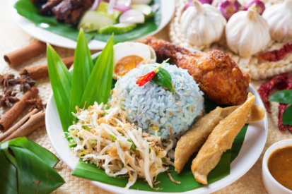
Prepare itinerary
Prepare itinerary
The itinerary will detail, in chronological order:
Destinations
Day destinations
Attractions, tours and sight-seeing
Arranged activities
Times
Notes:
Class Activity – View & research itineraries
Trainer to show examples of itineraries
Participants can conduct internet research and download examples of itineraries

Slide 190

Prepare itinerary
Prepare itinerary
Transport
Transfers
Accommodation
Meals
COMPLETE ACTIVITY 15
Notes:
Class Activity – View & research itineraries & Activity
Trainer to show examples of itineraries
Participants can conduct internet research and download examples of itineraries
Complete Activity 15

Slide 191

Monitor sales
Importance of monitoring sales
Analysing and monitoring sales regularly is an important aspect of any management role
By analysing sales performance, management can see clearly the direction in which our sales are headed, what has been successful and how we can adapt to increase the sales of specific packages and packages in general
Notes:
Class Activity – Discussion
Ask general questions:
How can you monitor sales?
What do you want to monitor?

Slide 192

Monitor sales
Preparing to monitor sales
Establishing facilities to record enquiries in relation to packages
Establishing internal systems to record package sales, including location of sale, seller, commissions and options selected
Arranging for sales data to be forwarded from related businesses
Notes:
Class Activity – Discussion
Ask general questions:
What is the purpose of these activities?
What are associated with these activities?

Slide 193

Monitor sales
Sales monitoring activities
Evaluating the results of different sales activities with reference to the nominated key performance indicators and sales objectives established by the organisation
Identifying the sales turnover achieved by our sales team
Track the performance of our sales team and develop appropriate strategies to help them perform better
Evaluating the sales performance of individuals in the organisation
Determine trends in sales and consumer preferences
Notes:
Class Activity – Discussion
Ask general questions:
Discuss these activities.

Slide 194

Monitor sales
Sales monitoring activities
Distinguish between strong and weak products / services
Better understand the performance of our products and services and determine how to exploit their strengths and enhance their weaknesses
Evaluating the success of different packages advertised to clients
Notes:
Class Activity – Discussion
Ask general questions:
Discuss these activities.

Slide 195

Monitor sales
Sales monitoring activities
Identifying satisfaction level of clients who have undertaken packages prepared by the organisation
Identifying innovative package suggestions
Make better sales forecast and set more realistic sales targets in future
Notes:
Class Activity – Discussion
Ask general questions:
Discuss these activities.

Slide 196

Monitor sales
Sales evaluation activities
Interviews with staff and customers
Comparison of actual sales or revenue statistics with expected or target figures
Analysis of data collected
Review of the budget
Consideration of ancillary benefits and problems that arose
Notes:
Class Activity – Discussion
Ask general questions:
Discuss these activities.

Slide 197

Monitor sales
Determining what data to collect
Quantitative data
Qualitative data
COMPLETE ACTIVITY 16
Notes:
Class Activity – Discussion & Activity
Ask general questions:
What are examples of information you would collect for each type of data?
How can you collect it?
Complete Activity 16

Slide 198

Plan marketing activities
Marketing planning activities
Identify marketing objectives
Identify marketing and sales activities
Training sales staff in relation to the packages
Designing client feedback tools
Notes:
Class Activity – Discussion
Ask general questions:
Discuss these activities.

Slide 199

Plan marketing activities
Identify marketing objectives
Whilst each organisation will have their own objectives, in line with the overall business plan, examples of travel and tourism marketing objectives:
What are examples of marketing objectives a tourism organisation would have?
Notes:
Class Activity – Discussion
Ask general questions:
Discuss the question in the slide
Refer to TM Page 134 for examples

Slide 200

Identify marketing and sales activities
Promotional methods
Personal selling
Sales promotions
Advertising
Publicity
Sponsorship
Public relations
Notes:
Class Activity – Discussion
For each type of promotional method discuss:
Its purpose
Advantages / disadvantages
Activities associated with it

Slide 201

Identify marketing and sales activities
Promotional methods
Newsletters
Special Events
Community Relations
Media Releases
On-site tour
Social media activities
COMPLETE ACTIVITY 17
Notes:
Class Activity – Discussion & Activity
For each type of promotional method discuss:
Its purpose
Advantages / disadvantages
Activities associated with it
Complete Activity 17

Slide 202

Training sales staff
Training sales staff in relation to the packages
Staff must be aware of:
Types of packages
Tourism products and services within the packages
Promotions on offer regarding the packages
Promotional and selling techniques to sell the packages
Notes:
Class Activity – Discussion
What training activities can take place?

Slide 203

Training sales staff
Timing of training
Customer service deficiencies exist which need to be addressed
New staff require training
New packages are introduced
New package products or services components are introduced
Retraining is required
Notes:
Class Activity – Discussion
What else dictates the need for training?
Is there any scheduled training that takes place each day, month, year?

Slide 204

Training sales staff
Types of training events
Whilst training events traditionally are focused towards formal training, in essence can be classified as any activity that enables staff to improve their service delivery in the selling of tourism packages:
What are types of training events that can be used to improve a staff member’s understanding of packages?
COMPLETE ACTIVITY 18
Notes:
Class Activity – Discussion & Activity
Ask general questions:
Discuss the question in the slide
Refer to TM Page 146 for examples
Complete Activity 18

Slide 205

Client feedback tools
Designing client feedback tools
What is the purpose of these tools?
What formats can be used?
What information should be included in these tools?
What are considerations when designing tools?
COMPLETE ACTIVITY 19
Notes:
Class Activity – Discussion & Activity
Ask general questions:
Discuss the questions in the slide
Complete Activity 19

